Slide 1
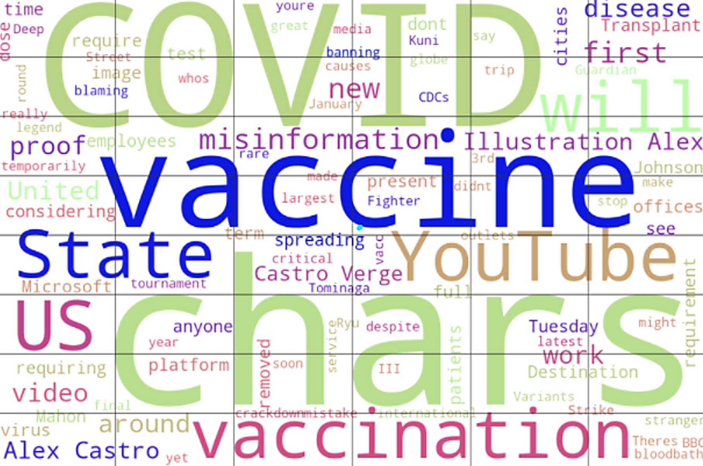
When will we be vaccinated?
A prediction model and sentiment analysis of covid vaccinations in Australia and the world
tian tran, nitin Dhawan, luke Konstantopoulos, matthew Buchanan and peter eng
Monash fintech bootcamp - September 2021
210906 V2.1

Slide 2
Covid and vaccination adoption
2019
Rumours and early reports of COVID
2020
COVID breaks out
2021
Vaccines developed
2022
Vaccination opens economies
Economic activity by country has been impacted by the COVID pandemic
The general global recovery is predicated on the ability to open up economies again
The general consensus is that herd immunity and safer opening of economies can be achieved at 70 – 80% vaccination of the population
Global vaccination rates by country have been varying in their adoption depending on
speed of vaccine development availability
production ramp up and availability
budget and supply chain constraints
sentiment to the vaccines and vaccine types
adoption and take up
Our prediction model uses LTSM model which sources windows of historical data to make a rolling prediction of one day forward (eg. Using a 7 days of historical data to predict the 8th day for training),
We then use that model to perform out of sample predictions (using the latest 7 day window period to predict tomorrow).
We then use that model to as to the date which vaccination rates are expected to be achieved by country
Note the data varies by country, and some countries have more more data than others. Therefore, the prediction model accuracy can vary according to the quality of the individual country data which has been submitted to Our World in Data

Slide 3

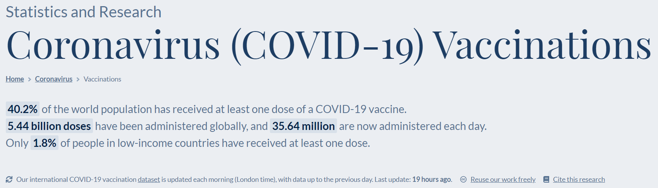
The data and libraries
The data is sourced from Our World in Data https://ourworldindata.org/coronavirus
The model sources data from reputable vaccination sources such as government and health organisations
The model is updated daily GMT and sourced from github into our model
The libraries included in our model cover
Our World in Data
SciKitLearn and NLTK
Panel Holoviz Dashboard
Widget for presentation

Slide 4
Our model

Slide 5
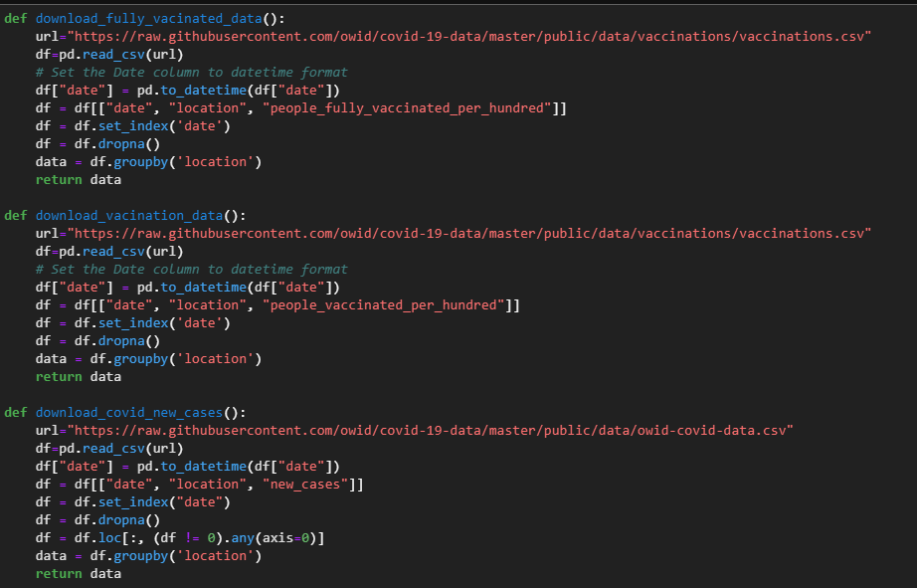
Model design: create model
Download the data

Slide 6
Model design: predictive output
Model performance graph

Slide 7

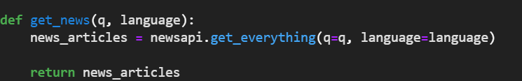

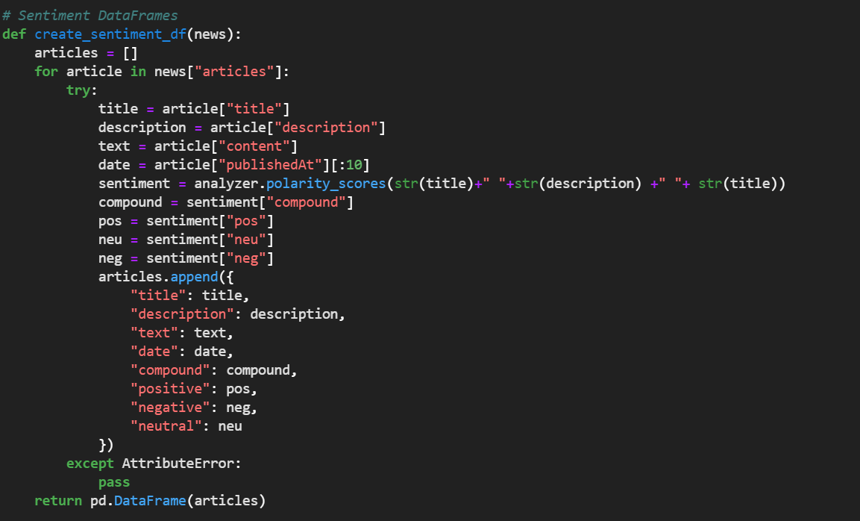
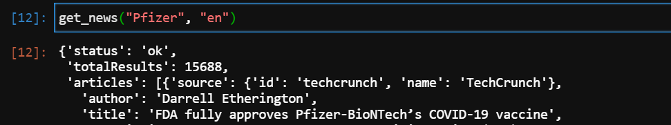
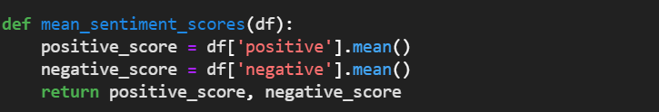
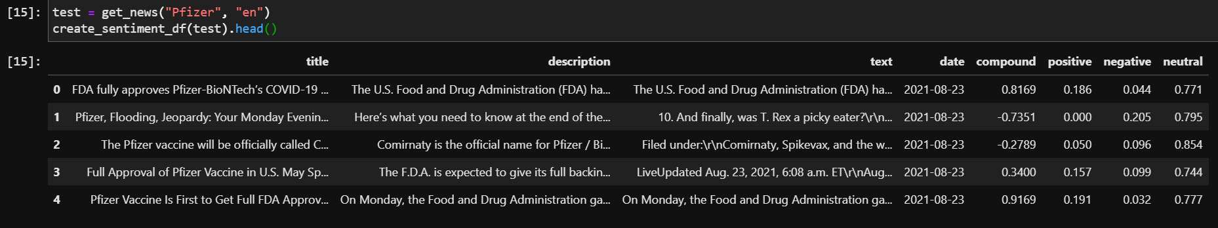
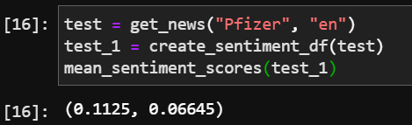
Model design: sentiment functions and output

Slide 8
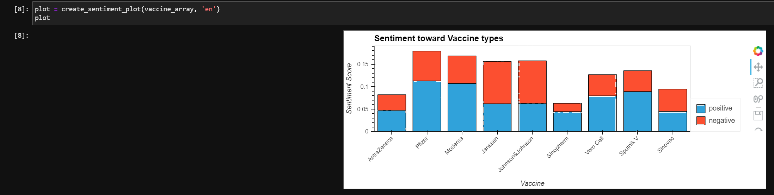
Plotting SENTIMENT TOWARDS ALL VACCINES

Slide 9
Dashboard output
Streamlit

Slide 10
Our prediction for australia
Graph and discussion

Slide 11
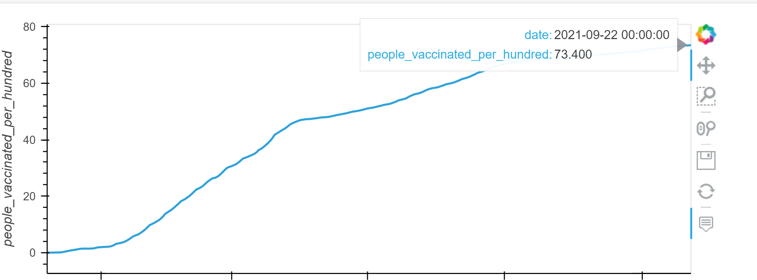
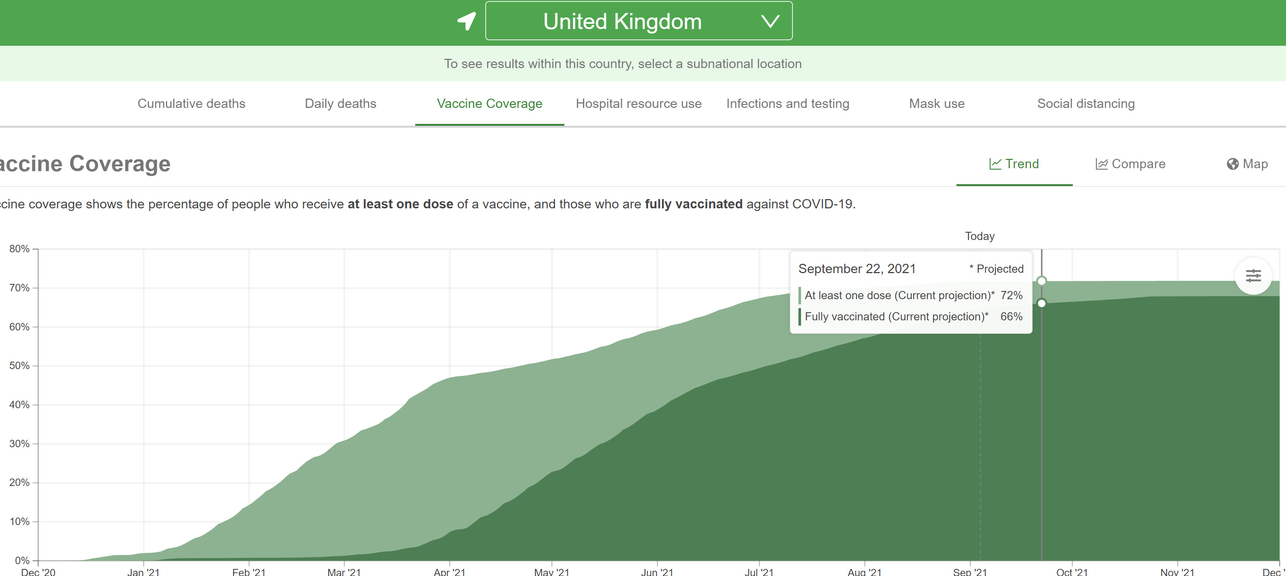
Compared to the government published models Our model tracks well
We built our predictive model using the LSTM prediction model structure…
… and the output has generated a comparable shape and prediction to the government published models

Slide 12
questions

